Slide 1
MFCC Feature Extraction
Hariyapuraju Kesava Sravan (CB.EN.U4ELC20023)
Kavya Balaji (CB.EN.U4ELC20029)
Konda Sujan Surya Reddy (CB.EN.U4ELC20031)
Namilakonda Hari Charan (CB.EN.U4ELC20041)

Slide 2
What is MFCC?
MFCC stands for Mel frequency cepstral coefficients. As you can see there are 4 words in the abbreviation.
Mel, frequency, cepstral and coefficients. The idea of MFCC is to convert audio in time domain into frequency domain so that we can understand all the information present in speech signals.
The way our ears will perceive the sound is different from how the machines will perceive the sound. Our ears have higher resolution at a lower frequency than at a higher frequency.
Whereas for the machine the resolution is the same at all the frequencies.
So we will use the Mel scale to map the actual frequency to the frequency that human beings will perceive. Then we will apply log and perform inverse Fourier transform of the output.
The MFCC model takes the first 12 coefficients of the signal after applying the IDFT operations. Along with the 12 coefficients, it will take the energy of the signal sample as the feature.
Along with these 13 features, the MFCC technique will consider the first order derivative and second order derivatives of the features which constitute another 26 features.
So overall MFCC technique will generate 39 features from each audio signal sample which are used as input for the speech recognition model.

Slide 3
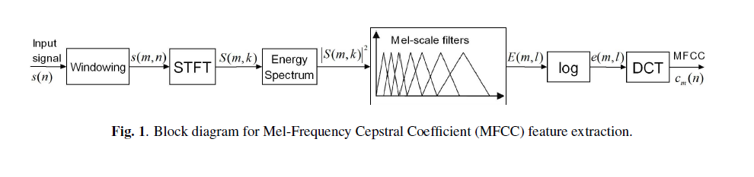
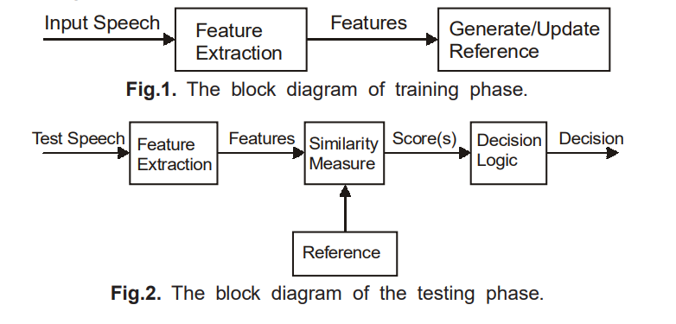
Block Diagram Representation of MFCC

